Slide 1
Low Power Optimization for GCC Compiler
Submitted by:
D. Rajeswar Rao – IIT2014055
Nishit Gupta – IIT2014502
Sachin Agarwal – IIT2014501
Saurabh Tanwar – IIT2014140

Slide 2
Aim
The aim of this project is to :
Study the effect of various gcc optimization levels on “Execution Time” and “Power consumed”.
Develop a patch for the GNU tool-chain that will aim at reducing Power at various Optimization levels.

Slide 3
Optimizing Compiler
Introduction:
An optimizing compiler tries to minimize or maximize some attributes of an executable computer program.
The most common requirement is to minimize the
time taken to execute a program,
the amount of memory occupied and
the power consumed by a program.

Slide 4
Levels of Optimization
– O0 (Level 0)
No optimization (the default); generates unoptimized code but has the fastest compilation time.
– O1 (Level 1)
Moderate optimization; optimizes reasonably well but does not degrade compilation time significantly.
Optimization : global register allocation, dead-code elimination etc.
– O2 (Level 2)
Full optimization; generates highly optimized code and has slower compilation time than O1.
Optimization : O1 + loop unrolling, thread jumps optimization etc.
– O3 (Level 3)
Full optimization as in `-O2'; also uses more aggressive automatic inlining of subprograms within a unit (inlining of Subprograms) and attempts to vectorize loops.
Optimization : O2 + prefetching, code motion, scalar replacement etc.
– Ofast (Level 4)
Perform level-3 optimizations plus disregard strict standards compliance.

Slide 5
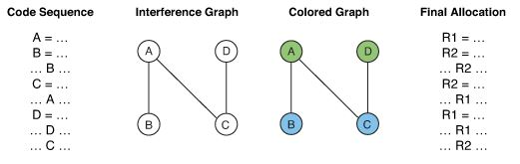
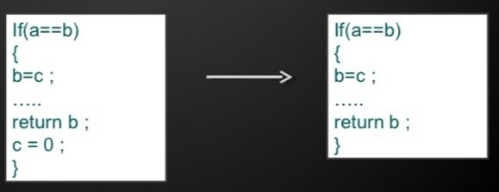
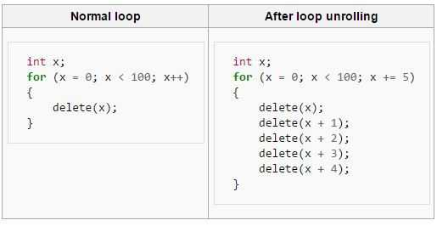
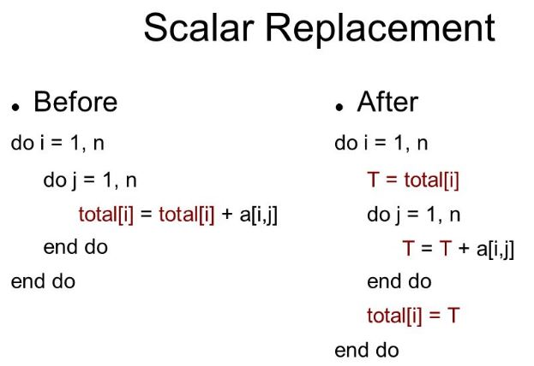
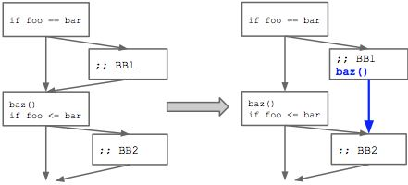
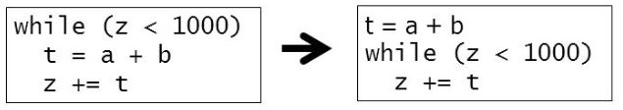
Optimization Techniques
Global Register Allocation by Graph Coloring
Dead Code Elimination
Loop Unrolling
Code Motion
Jump Threading

Slide 6
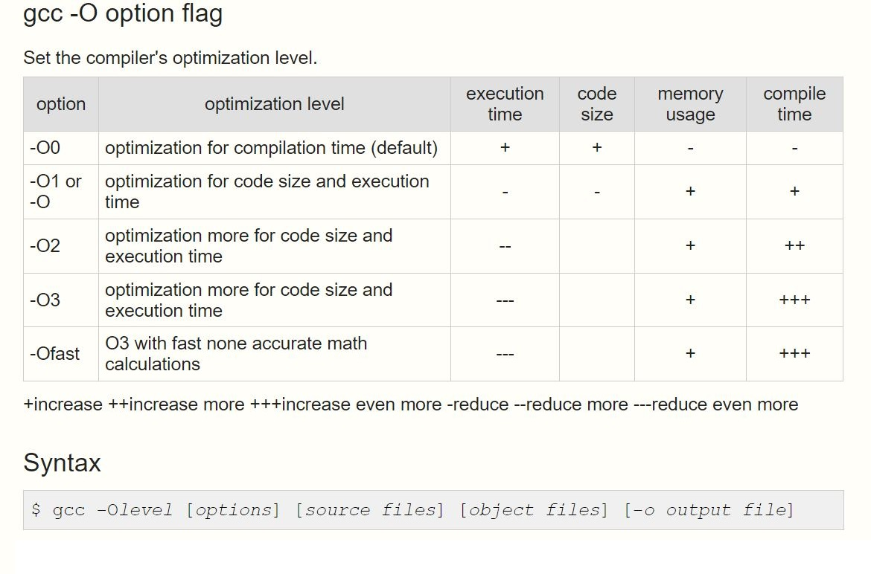

Slide 7
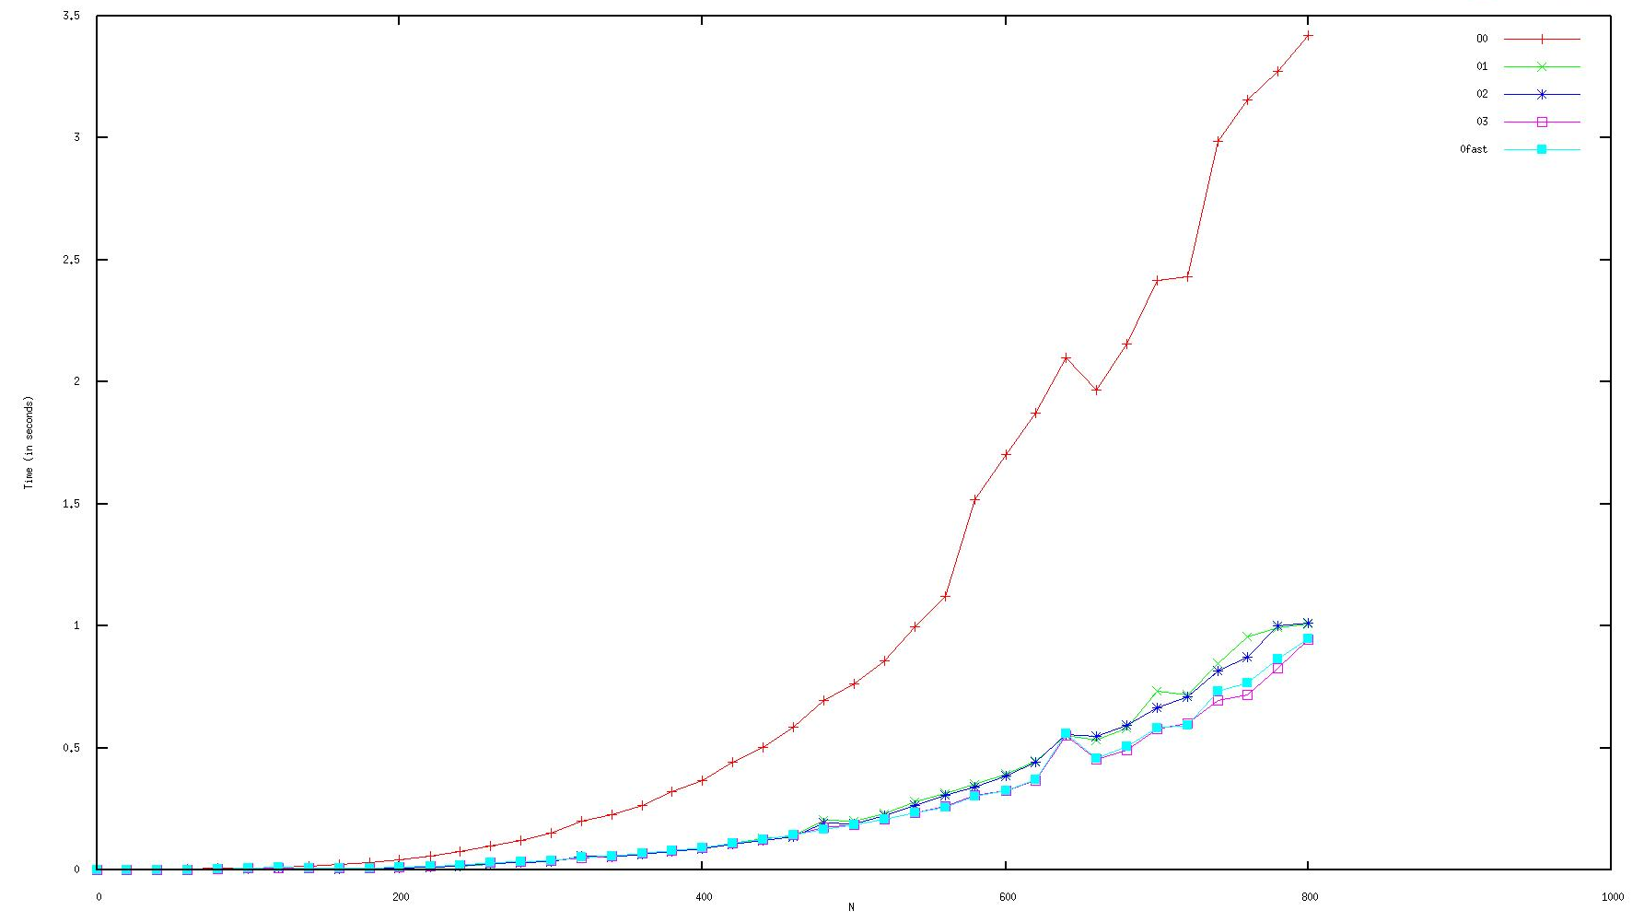
Execution Time Survey
Matrix Multiplication Program : Running Time Complexity – O(n³)

Slide 8
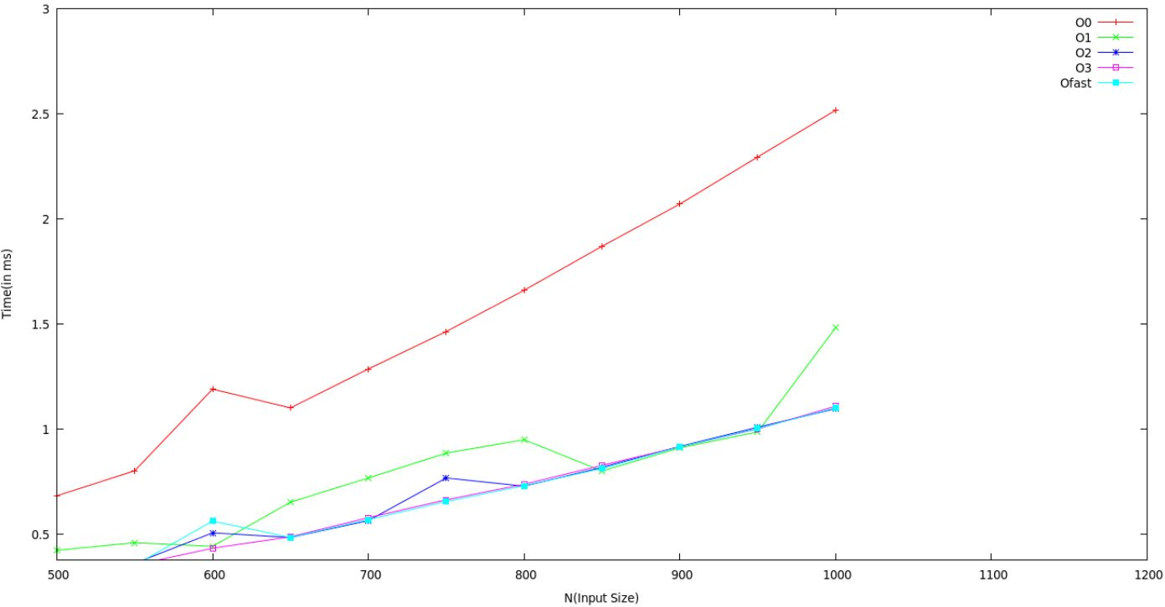
Execution Time Survey
Bubble Sort Program : Running Time Complexity – O(n²)

Slide 9
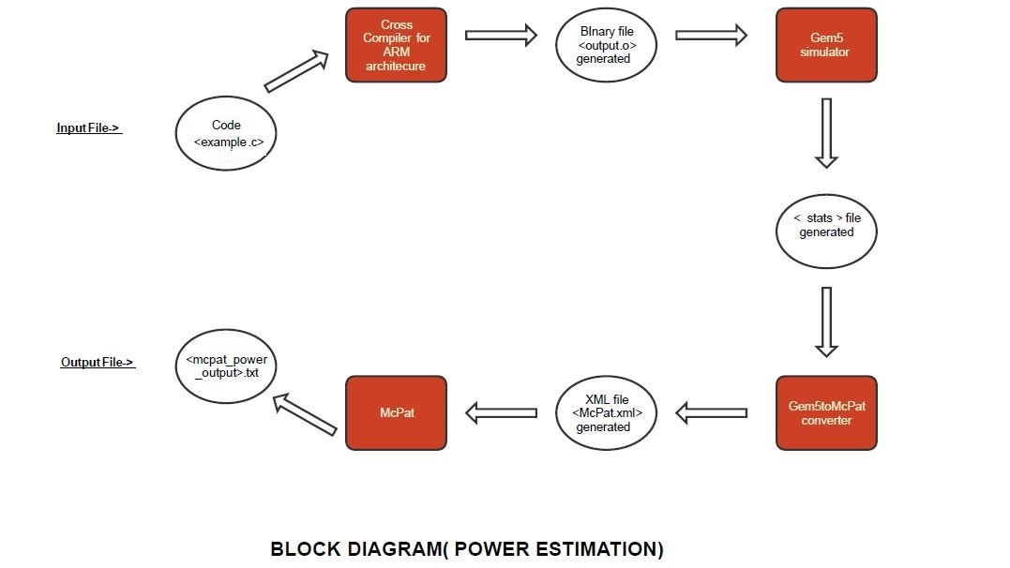
Steps to Measure Power

Slide 10
Power Survey
Matrix Multiplication Program : Running Time Complexity – O(n³)
n | O0 | O1 | O2 | O3 | Ofast
200 | 522.784mW | 570.949mW | 571.1mW | 571.1mW | 571.1mW
400 | 511.355mW | 517.956mW | 517.966mW | 517.966mW | 517.966mW
Bubble Sort Program : Running Time Complexity – O(n²)
n | O0 | O1 | O2 | O3 | Ofast
1000 | 513.232mW | 513.4996mW | 513.4996mW | 513.4997mW | 515.264mW

Slide 11
Conclusion of Analysis
After Execution Time Analysis on both Matrix Multiplication and Bubble Sort, it was observed that
RUNNING TIME
For Large Values of N:
reduces considerably (for larger inputs) from O0 to O1,
then reduces relatively less from O1 to O2,
and similarly for other levels, with Ofast being the best.
For Small Values of N
does not reduce considerably from O0 to O1,
then reduces relatively less from O1 to O2,
and similarly for other levels, with Ofast being the best.

Slide 12
Conclusion of Analysis
POWER
increases from O0 to O1,
then increases relatively less from O1 to O2,
then very slow increase (or similar) from O2 to O3
then either remains stable or increases from O3 to Ofast
Therefore, Power consumption increases from O0 to Ofast.

Slide 13
Literature Survey
S No. | Author | Paper Title | Year | Crux | Venue
1. | David Branco and P. R. Henriques | Impact of GCC Optimization levels in energy consumptions during C/C++ program execution. ^{[1]} | 2015 | Presenting experimental setup and method followed to measure and compare resources consumed by a program during execution. | 2015 IEEE 13th International Scientific Conference on Informatics.
2. | V.Tiwari, Sharad Malik and A.Wolfe | Compilation techniques for low energy : an overview^{[2]} | 1994 | Used techniques such as Re-ordering instructions to reduce switching and using patterns for Code generations to reduce Power. Conclusion: Conducted an experiment which reduced power upto 40%. | In Low Power Electronics, 1994, Digest of Technical Papers, IEEE Symposium.
3. | Mahmut Kandemir, N. Vijaykrishnan and Mary Jane Irwin | Power aware computing^{[3]} | 2002 | Focuses on two power aware low-level techniques: 1) Instruction Scheduling for reducing switching acitivity, and 2) Post-compilation relabeling of Register for reducing Power | In Chapter Compiler Optimizations for Low Power Systems
4. | Madhavi Valluri and Lizy K.John | Is Compiling for Performance – Compiling for Powers? ^{[4]} | 2001 | They present a quantitative study where they examine the effect of the standard optimizations levels −01 to −04 on power and energy of the processor. They also evaluate the effect of four individual optimizations on power/energy and classify them as “low energy” or “low power” optimizations. | Springer US, Boston, MA
5. | Ulrich Kremer | Low Power/Energy Compiler Optimizations^{[5]} | 2005 | Comparison of Power & Energy and Performance Analysis and concluded that both of them are different strategies and one can not be a by-product of the other. | Low-Power Electronics Design, CRC Press, 2005

Slide 14
Motivation
As suggested from literature and the survey conducted, the focus of compiler optimization techniques have been on :
reducing execution time of program.
and power reduction has been considered a by product of it.
i.e. Reducing Power was not taken into consideration during the Optimization
As a result, compiler optimizations for low power have remained mostly unexplored.
Hence, there is a need for work in finding out low power compilation techniques and study their effect.

Slide 15
Problem Statement
Exploring various compiler optimization techniques (GCC) and study their effect on power optimization on ARM Architecture.
Develop low power compiler techniques as patches for gnu tool chain.

Slide 16
Power Optimization
Power consumption optimizations for embedded systems targets at reducing the power during execution thus making systems much power efficient and less heat generation, and the research on this is growing every year. Important approaches that can be named include:
Dynamic frequency and voltage scaling (DVS) - idea of DVS is to change the voltage of the power supply unit in some places (called power management points, PMPs) during program execution, such that energy consumption decreases but the needed functionality is still maintained.

Slide 17
Power Optimization (cont.)
Tuning of memory optimizations
Memory subsystem is considered one of the most energy-consuming parts of embedded devices. Hence, minimization of memory accesses and optimization of cache behavior is an important approach for lowering power consumption.

Slide 18
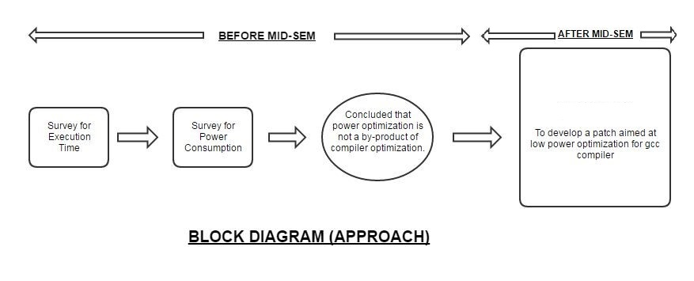
Work Flow

Slide 19
Future Goals
To Study Various Power Optimization Techniques.
To Develop a patch for the GNU tool-chain that will aim at reducing Power at various Optimization levels.
To ensure/prove that the functionality of the program is conserved after applying optimization techniques.

